Slide 1
The Hobby App
Chris Boffa
Zhe Sun
Haoxuan Li
Xueshi Wang
SSW-690 - Spring 2019

Slide 2
Objective
This project will help the user to find a partner who has the same hobbies as them, offering them a chance to meet together and hold activities, and share their experiences and stories with other users.

Slide 3
The Hobby App REST API Architecture Objectives
Uniform Interface – Client / Server approach allows us to follow a uniform API for both a the web and mobile app
Reliability – The backend server can ben cachable and the system can be layered to remove the separation of concerns
Performance – Allow the application to be used by many users in many different locations
Simplicity – The front end can handle the view layer while the backend will be focused on object creation, read, update, and deletion.

Slide 4
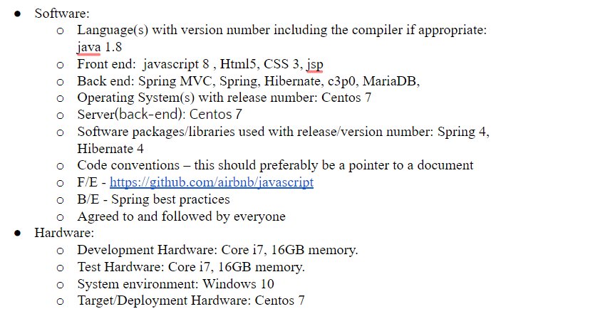

Slide 5
